Slide 1
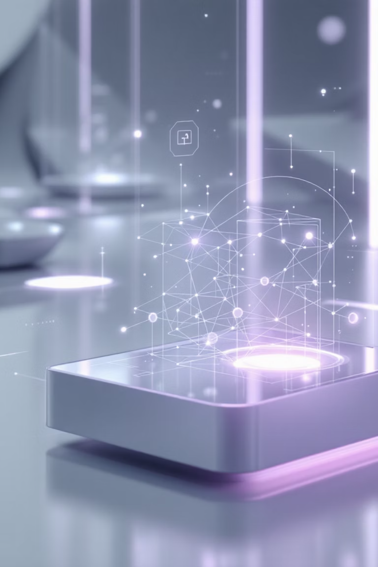
LangGraph Visual Learning Assistant
AI-Powered Educational Content Generator
Transforming how people learn through intelligent visual analysis and adaptive content generation.

Slide 2
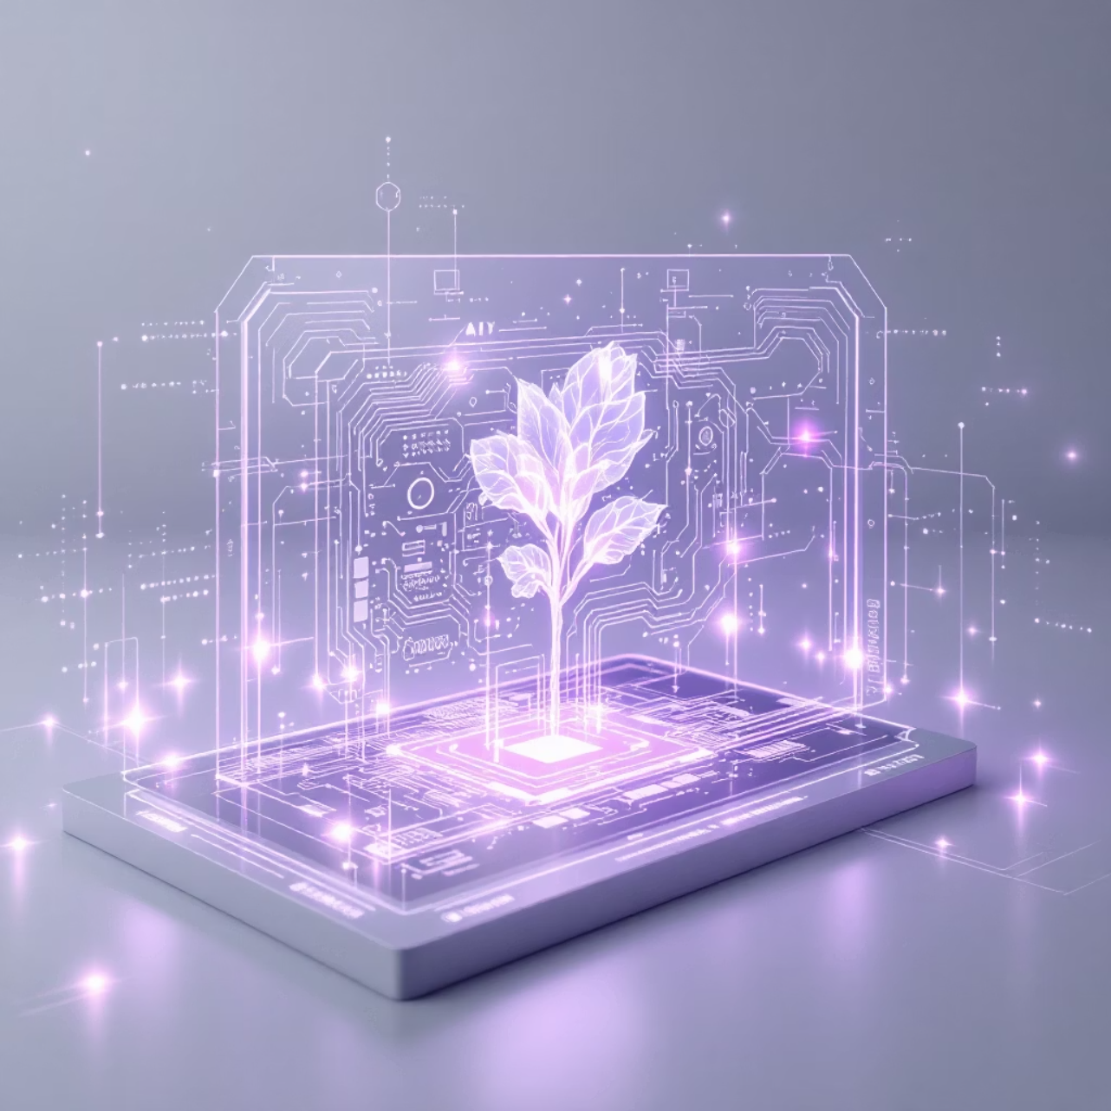
Current Implementation: What We've Built
Our Visual Learning Assistant leverages cutting-edge Vision AI to generate educational content that truly connects with visual materials. The system analyzes actual images to create precise, context-aware explanations tailored to each learner's age and knowledge level.
The LangGraph pipeline orchestrates a sophisticated workflow: lesson planning, intelligent image search, vision analysis, content generation, and quiz creation—all delivered through real-time streaming with downloadable learning packages.

Slide 3
Problems We're Solving Today
Generic Content ❌
One-Size-Fits-All ❌
Time-Consuming Planning ❌
Problem: Traditional educational content doesn't match actual visuals, creating disconnect between what students see and what they read.
Problem: Content isn't personalized for individual learner's age or knowledge level, limiting effectiveness.
Problem: Manual lesson planning consumes hours of educator time and lacks consistency.
Our Solution: Adaptive content generation spans Elementary to Adult levels and Beginner to Advanced proficiency.
Our Solution: Automated comprehensive lessons include curated images, detailed explanations, and assessment quizzes.
Our Solution: Vision AI analyzes real images and references specific visual elements in explanations.

Slide 4
How Our Current System Works
01
02
03
Lesson Planning Node
Image Search Node
Vision AI Node
Structures key concepts and creates a coherent learning framework tailored to the topic.
Fetches relevant educational images that best illustrate the concepts being taught.
Analyzes images using Gemini 2.0 Vision to extract visual elements and context.
04
05
Content Generation Node
Quiz Node
Creates detailed explanations that directly reference specific visual elements from the images.
Generates targeted assessment questions to reinforce learning and measure comprehension.
Technology Stack: LangChain + LangGraph + Gemini 2.0 + Streamlit

Slide 5
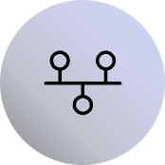

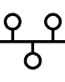



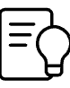

Future Enhancement Plan
Next-Level Innovation on the Horizon
Roadmap Generation
Dual-Agent System
Break complex topics into progressive learning paths with clear milestones and dependencies.
Separate Teaching Agent maintains lesson flow while Query Agent handles questions independently.
Notion Integration
Content Adaptation
Automatically upload and organize learning notes into a structured, searchable database.
Dynamically modify explanations based on user questions and detected knowledge gaps.

Slide 6
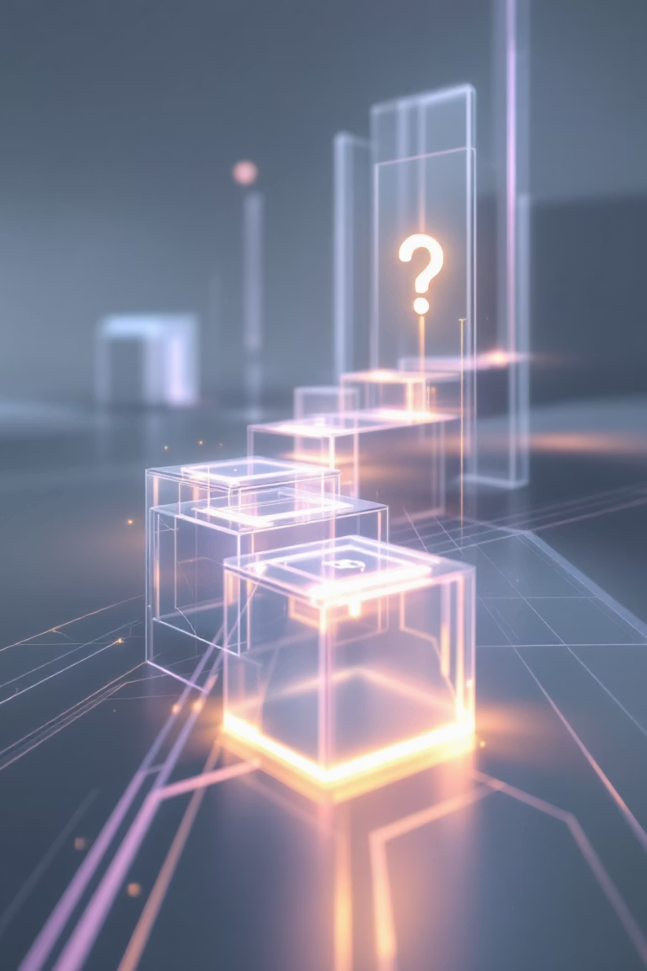
The Critical Problem We'll Solve Next
LLM Context Loss During Learning
❌ The Problem
✅ Our Solution
Current LLMs forget their "step-by-step" teaching mode when users ask clarifying questions mid-lesson. This breaks the learning flow and forces users to restart or lose their place.
A sophisticated Dual-Agent System that maintains teaching continuity while handling interruptions gracefully.
Teaching Agent: Maintains step-by-step flow without interruption
Example scenario: You ask for a step-by-step explanation of gradient descent. Halfway through, you ask "What is a derivative?" The LLM answers your question but completely forgets to continue the original step-by-step explanation.
Query Agent: Handles clarifying questions independently
Result: Ask questions anytime without losing your place

Slide 7


How the Future System Works
Multi-Agent Architecture in Action
Roadmap Generation
User enters topic → System generates structured learning roadmap (Module 1 → Module 2 → Module 3...)
Teaching Begins
Teaching Agent starts Module 1 with step-by-step progression through concepts
Question Handling
User asks clarifying question → Query Agent provides answer without interrupting teaching flow
Seamless Continuation
Teaching Agent continues exactly where it left off, maintaining perfect context
Adaptive Response
If knowledge gaps detected, content auto-adapted to fill missing prerequisites
Knowledge Management
All notes uploaded to Notion in real-time with progress tracked across entire learning journey
Key Innovation: Context is preserved across interruptions, ensuring unbroken learning flow regardless of how many questions you ask.

Slide 8





Future Benefits: Why This Matters
No Context Loss
Progressive Learning
Adaptive Content
Ask questions anytime without breaking the learning flow or losing your place in the lesson.
Structured roadmap ensures proper sequencing from foundational concepts to advanced mastery.
System detects knowledge gaps and automatically fills missing prerequisites for complete understanding.
Centralized Knowledge
Complete Journey
All learning materials organized automatically in Notion for easy reference and review.
Guided path from beginner to mastery on any topic with measurable progress tracking.

Slide 9

The Vision: Uninterrupted Learning
Current System
Future System
Visual AI-powered content generation
Multi-agent learning journey
Image analysis with Vision AI
Context preservation during interruptions
Adaptive content for all levels
Progressive roadmap generation
Real-time streaming delivery
Notion integration for knowledge management
We're building the future of personalized, adaptive learning—where AI understands not just what you're learning, but how you learn best.

Slide 10

Questions?
Current Achievement
Visual AI-powered content generation with image analysis and adaptive learning
Future Innovation
Multi-agent learning journey with context preservation and intelligent roadmap generation
Thank you for your time. Let's discuss how we can transform education together.

